Slide 1

DIGITAL MARKETING
CAPSTONE PROJECT
PHASE I, II & III
PRESENTED BY – LT 4
Hunny Gupta | Swati Bahety | Yash Arora | Soumya Soni

Slide 2
PHASE - I

Slide 3
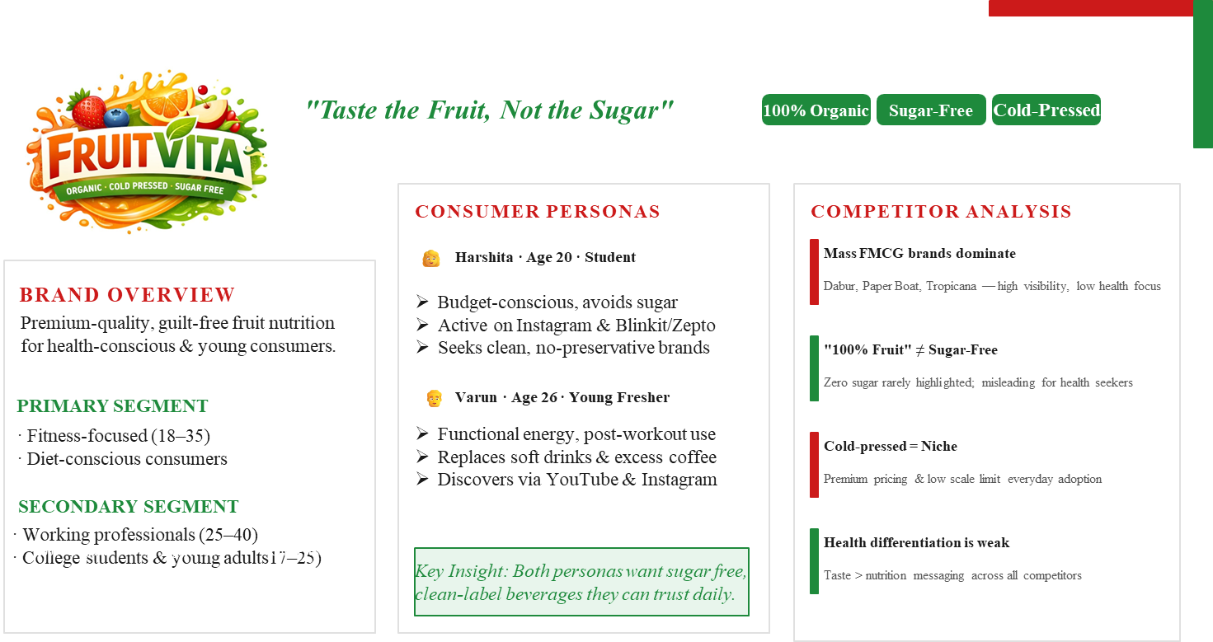

Slide 4
PHASE - II

Slide 5
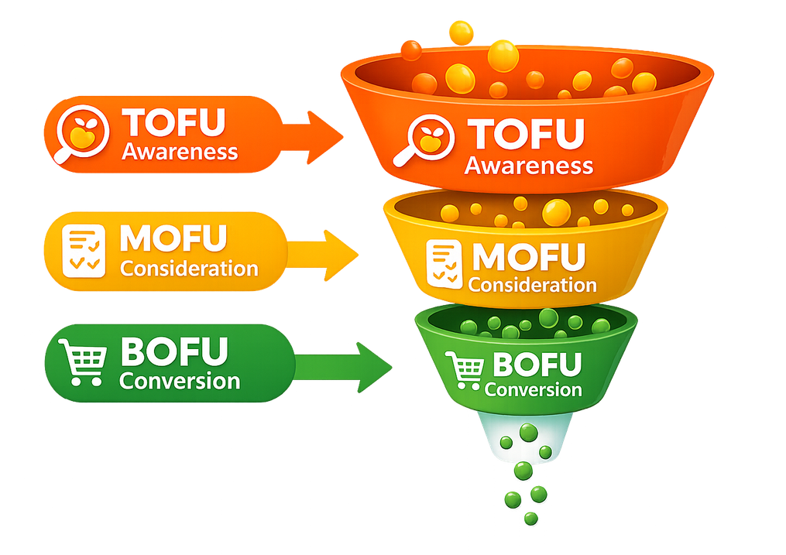
FUNNEL DESIGN & OBJECTIVES
1
TOFU - Awareness stage
Position FruitVita as a sugar-free alternative via Instagram wellness reels and influencer collaborations.
OBJECTIVE: Build brand visibility and generate curiosity among health-conscious audiences.
MOFU - Consideration Stage
Educate on cold-pressed advantages and ingredient sourcing via the website and social media listings.
OBJECTIVE: Build credibility and highlight FruitVita’s affordable premium positioning.
2
Navigating the FruitVita customer journey from initial awareness to high speed conversion.
BOFU - Conversion Stage
Leverage quick-commerce platforms (Blinkit, Zepto) for fast delivery and impulse-buy bundle deals.
OBJECTIVE: Convert interest into immediate action through convenience and attractive packaging.
3

Slide 6
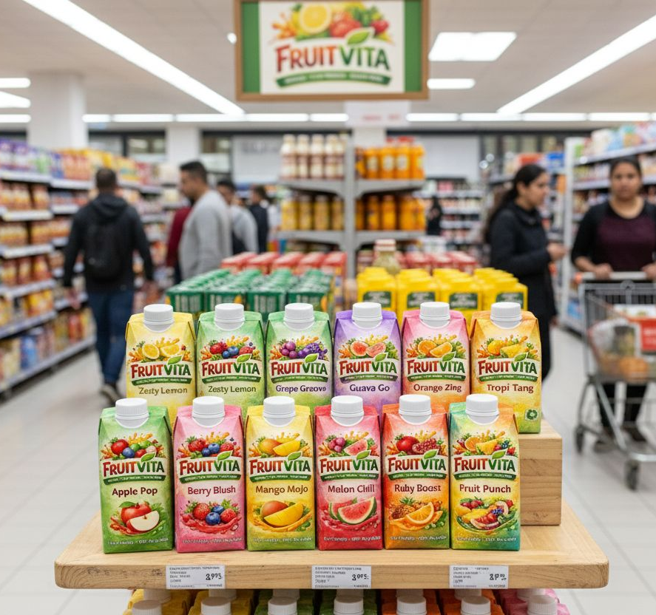
CONTENT STRATEGY & ENGAGEMENT
“Engaging health-conscious consumers with high-impact visuals and strategic value offerings”
TOFU AWARENESS
Wellness reels, influencer healthy beverage swaps, and organic ingredient visuals.
MOFU CONSIDERATION
Cold-press process videos, sourcing stories, and educational nutrition articles.
BOFU CONVERSION
NURTURING
Quick-commerce spotlights, bundle packs
Retargeting ads, health tip newsletters, and automated repeat purchase reminders.
(Study Boost), and convenience messaging.
“LEAD MAGNETS & VALUE HOOKS”
First-purchase discounts for new website sign-ups.
Day Healthy Drink Routine guides.
Introductory trial bundles for first-time customer.

Slide 7
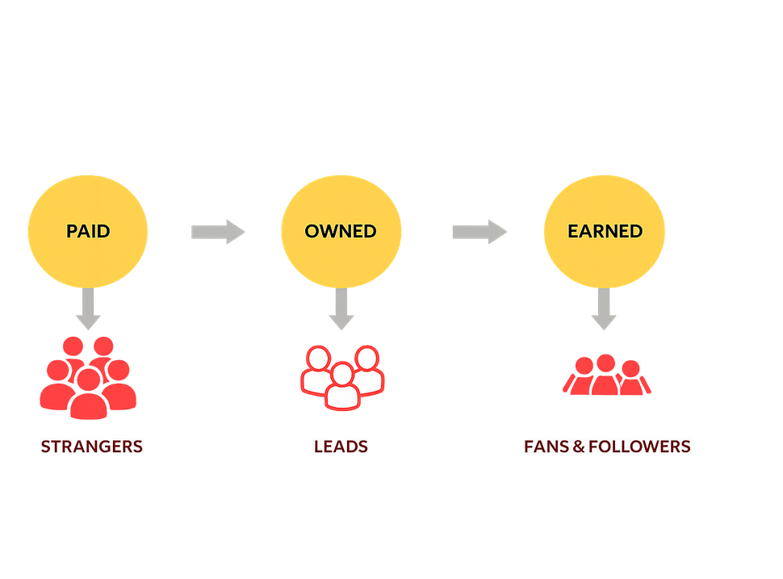

POEM FRAMEWORK APPLICATION
PAID
OWNED
EARNED
Targeted IG & FB Ads
  Sponsored Influencers
  Google Display Ads
  Quick-commerce Placements
Official Brand Website
  Brand Social Media Pages
  Email & WhatsApp Updates
  Product Detail Pages
Customer Reviews & Ratings
Organic Social Mentions
Wellness Blog Features
Word-of-Mouth
Recommendations
A balanced media mix to drive discovery, build credibility, and strengthen consumer trust for FruitVita.
ROLE: drive discovery and attract first-time users.
ROLE: educate consumers and build brand identity.
ROLE: strengthen trust and
influence decisions.

Slide 8
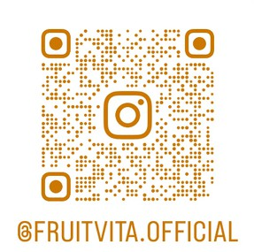
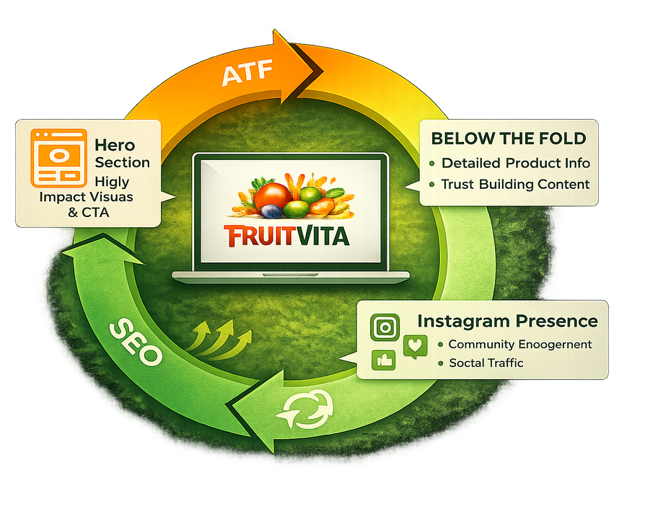
WEBSITE & SEO STRATEGY
WEBSITE ARCHITECTURE (CRDC)
Website Link: https://fruitvitaa.lovable.app
ATF: Above The Fold
High-impact visuals and core promise to
capture immediate attention.
BTF: Below The Fold
Detailed product education, trust-building, and social proof elements.
SEO Integration
3 embedded blogs focusing on cold-pressed
benefits and nutritional science following the Claude procedure.
Instagram Presence
Primary touchpoint for community engagement,
wellness reels, and TOFU discovery.
FruitVita's digital hub: Driving credibility through the CRDC framework and organic growth via SEO.

Slide 9
PHASE - III

Slide 10
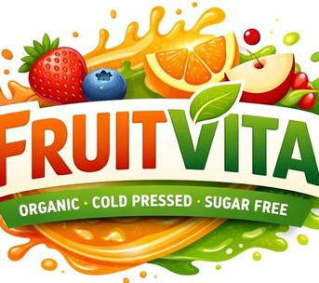
P H A S E – 3
DELIVERABLES
A.
Google Ads — Keyword Planning, Audience, Campaign & Ad Copies
B.
Meta Ads — Campaign Objectives & Creative Ad Copies
C.
Social Media — IG & FB content (Videos, Static, Carousel)
D.
Email Marketing — Lead Magnets, Welcome Series & Nurturing

Slide 11
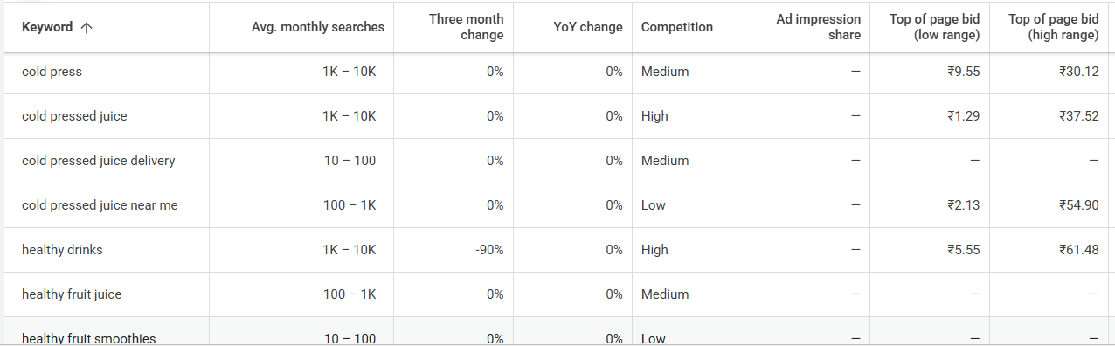
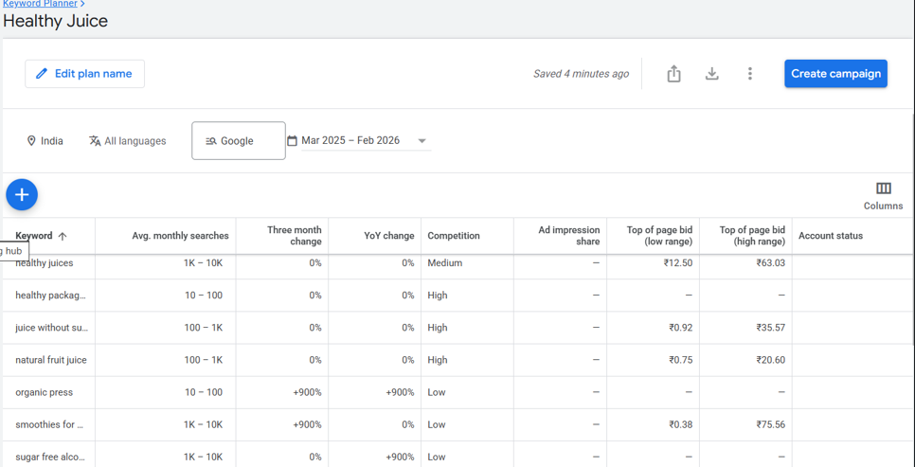
GOOGLE ADS –
KEYWORD PLANNING
SELECTED KEYWORDS
Keyword Strategy
High-intent search terms targeting health-conscious consumers, professionals & college students actively looking for healthy drinks
Match our USP - healthy, cold-pressed, sugar-free
High-intent searches = users ready to purchase
Consistent search demand shows growing health trend

Slide 12
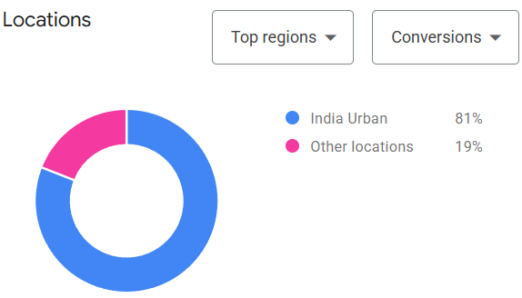
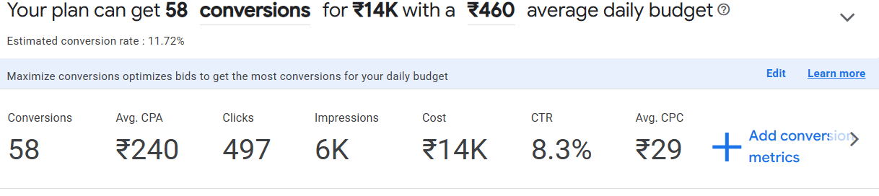
GOOGLE ADS — KEYWORD PERFORMANCE FORECAST
KEYWORD IDEAS TABLE
FORECAST GRAPH
High searches for cold pressed & healthy drinks show strong health demand
High competition confirms established premium healthy drink market
Keywords like near me & delivery show high purchase intent
8.3% CTR forecast indicates strong keyword–product relevance
Estimated conversions justify budget-efficient performance potential

Slide 13
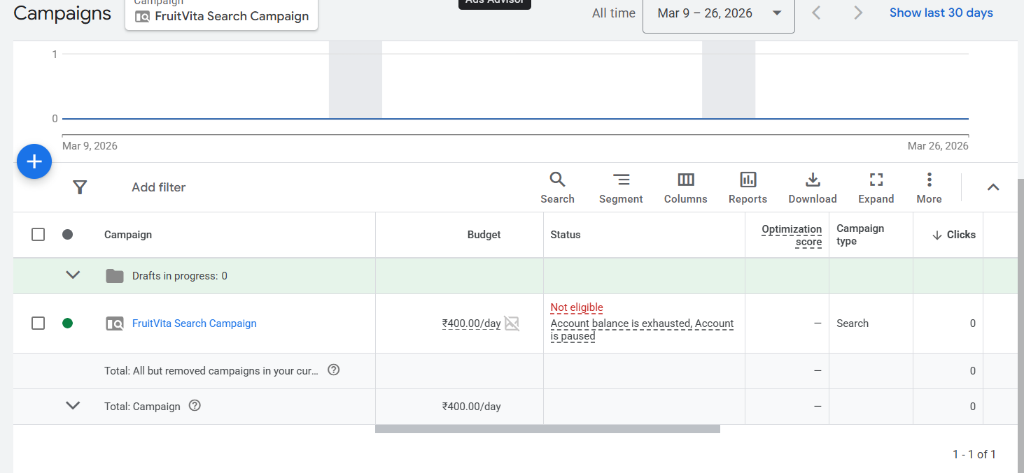
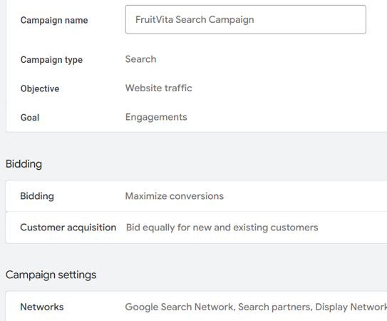
GOOGLE ADS CAMPAIGN SETUP
Search campaign captures users already searching healthy drink alternatives
Website traffic objective helps users understand benefits before buying
Maximize conversions targets users with higher purchase intent
Pan India targeting helps identify high-demand health-conscious markets
Test budget used to analyse performance before scaling

Slide 14
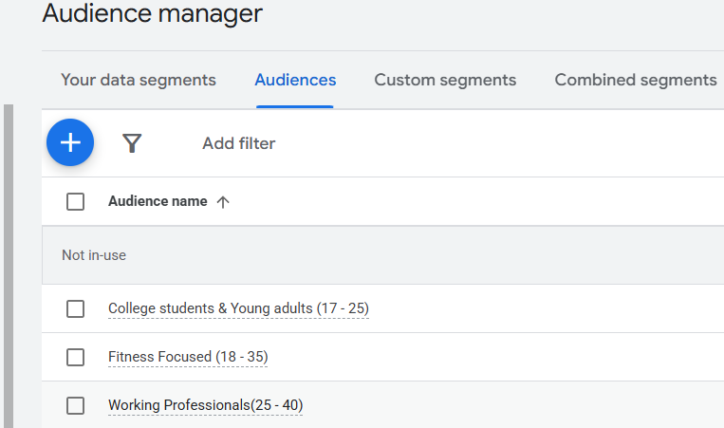
GOOGLE ADS — AUDIENCE MANAGER
KEY INSIGHTS
• Fitness & diet-focused users more likely to prefer sugar-free healthy drinks
• Targeting health-conscious lifestyle segments increases relevance of ads
• Working professionals need convenient healthy alternatives for busy routines
• College students show interest in trendy, healthy beverage options
• Segmenting audience helps deliver more personalized and effective messaging

Slide 15
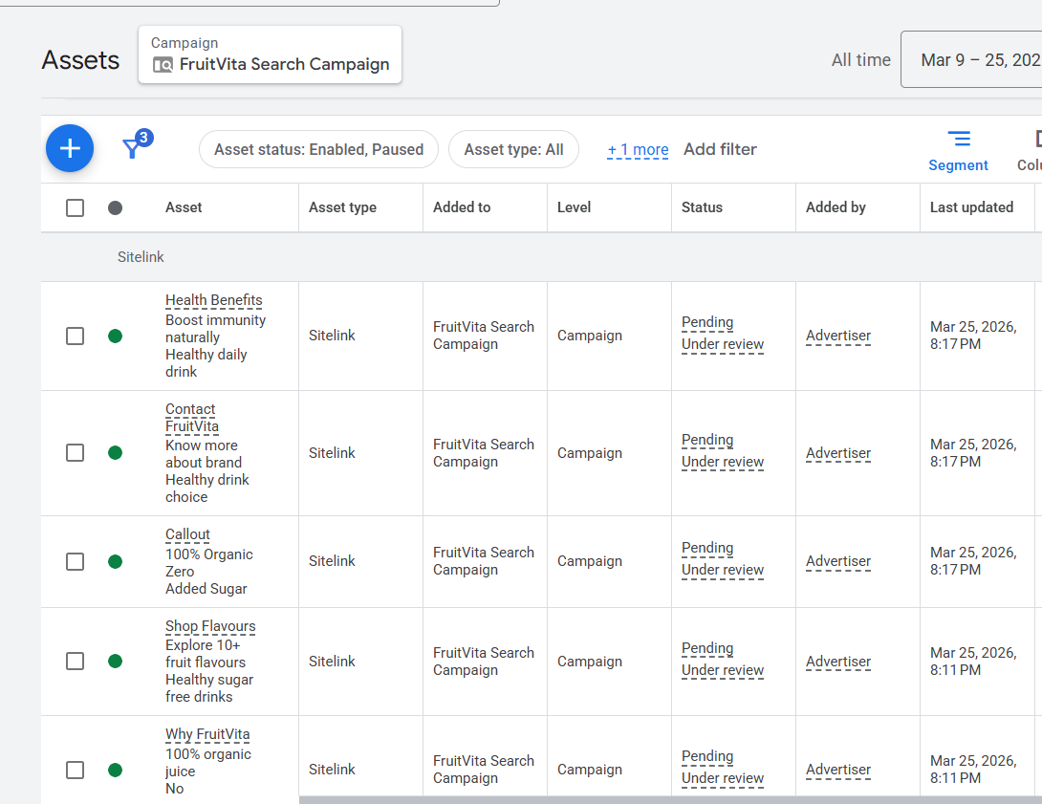
GOOGLE ADS — AD EXTENSIONS SITELINKS & CALLOUTS
SITELINKS TABLE — ALL EXTENSIONS CREATED
KEY INSIGHTS
Highlight key USP: Zero Sugar, Organic, Healthy
Provide quick access to flavours, benefits, brand info
Improve ad visibility & click-through rate
Helps users directly reach relevant landing sections
Builds trust through clear health positioning
Increases chances of qualified clicks & conversions
SITELINK CREATION FORM
Ad Extensions Summary
Shop Flavours sitelink · fruitvita.lovable.app · Explore 10+ fruit flavours

Slide 16
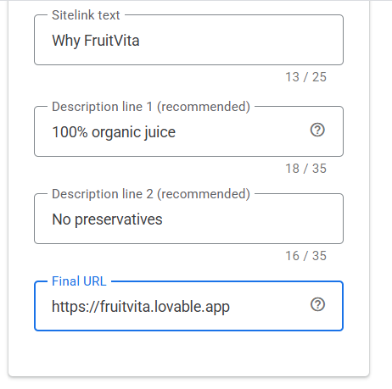
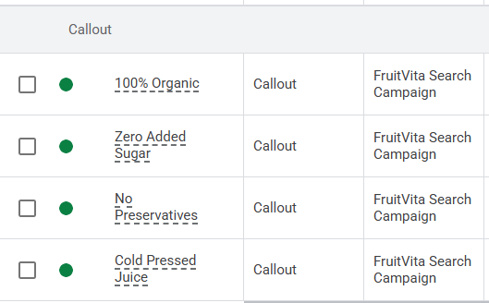
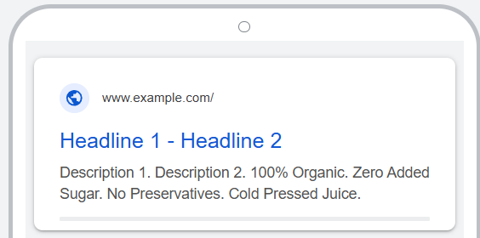
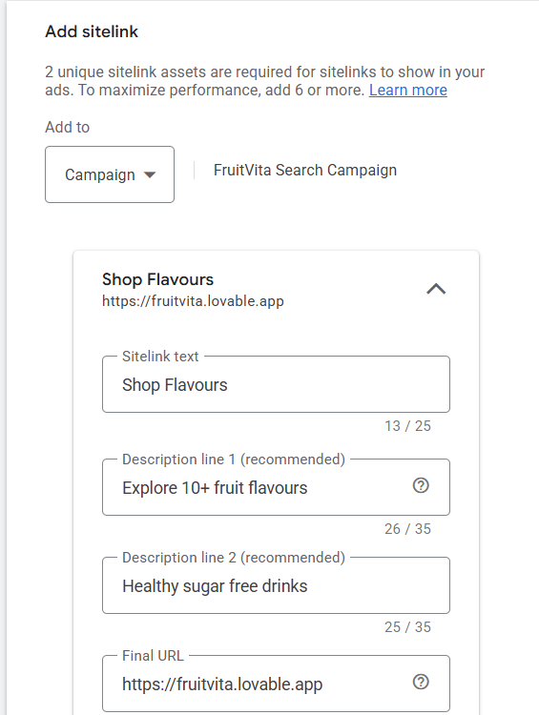
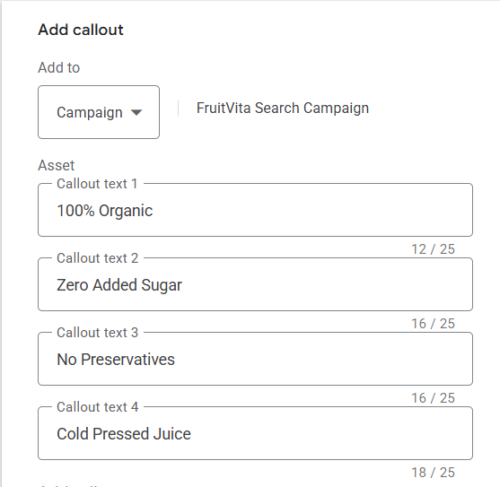
CALLOUT EXTENSIONS KEY INSIGHTS
Communicates core health USP instantly
Reinforces premium & clean positioning
Increases ad credibility & trust
Highlights key benefits without extra click
Improves ad relevance & quality score
Encourages health-conscious user action

Slide 17
GOOGLE ADS – AD COPIES
( 5 COPIES)
REAL FRUIT. ZERO SUGAR.
FruitVita Cold Pressed Juice
DITCH SUGARY DRINKS TODAY
Try FruitVita — India's Cleanest Juice
100% organic, cold-pressed fruit juice with zero added sugar. Order now on Blinkit.
No artificial flavours. No preservatives. Just pure fruit nutrition delivered fast.
Ad Copy Showcase
Headlines: 30 chars max Descriptions: 90 chars max
All copies highlight FruitVita's
core USP — Real Fruit, Zero Sugar
10+ FLAVOURS | SUGAR FREE
FruitVita — Healthy Drinks India
COLD PRESSED. NUTRIENT RICH.
FruitVita Organic Fruit Juice
From Mango Mojo to Apple Pop — find your daily health fix. Free delivery available.
Vitamins, antioxidants & electrolytes locked in every sip. Order online today.
5 Unique Ad Copies Created
Healthy Juice Under ₹99
FruitVita — Affordable & Organic
Premium cold-pressed juice without the premium price. Available on quick commerce.

Slide 18
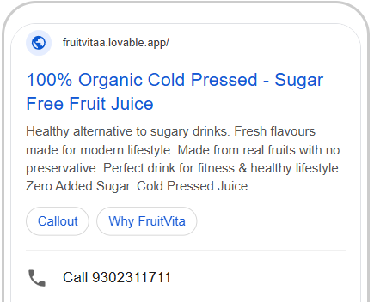
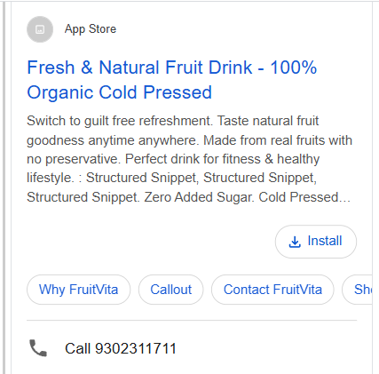
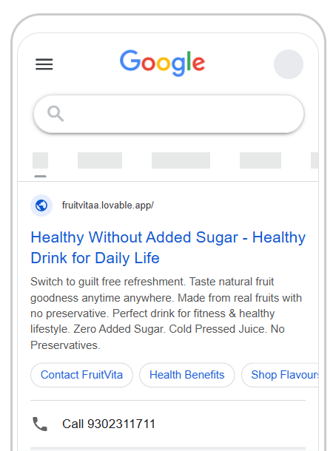
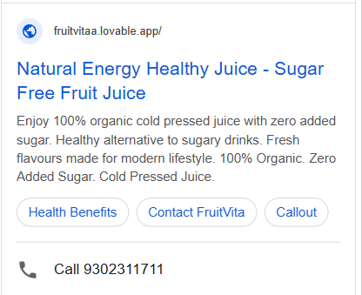
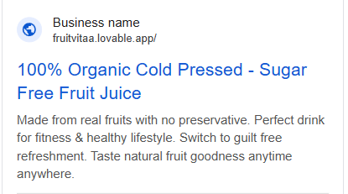

Slide 19
META ADS – CAMPAIGN OBJECTIVES
CAMPAIGN OBJECTIVES ACROSS FUNNEL
Brand Awareness
Meta Ads
TOFU
Platform: Instagram Reels + FB Stories
Targeting: Health & wellness interest, 18–35, urban
Budget:
₹200/day
Facebook & Instagram ads targeting health- conscious consumers across the funnel
Engagement & Traffic
MOFU
Platform: Instagram Carousels + FB Feed
Targeting: Website visitors, lookalike audiences
Budget: ₹180 /day
IG+FB
Platforms
Conversions
18–35
Target Age
Platform: Instagram Shopping + FB Retargeting
Targeting: Cart abandoners, product page visitors
BOFU
₹500
Daily Budget
Budget: ₹120/day

Slide 20
META ADS – CREATIVE AD COPIES
CREATIVE AD CONCEPTS
Awareness
Video Ad (Reel/Story)
"Still Drinking Sugar?" Stop Motion Reveal
Creative Strategy
15s reel: Sugar vs FruitVita side-by-side. Hook in first 3 seconds. CTA: Shop on Blinkit
Visual-first creatives optimized for mobile feed & stories
Consideration
Static Post (Feed)
"Swap Sugar for FruitVita" — Comparison Graphic
5 Videos
Clean white BG, product hero shot, 3 key USPs. CTA: Order Now. Target: Health interest audience
5 Static
Conversion
Carousel Ad
"Meet the Range" — 5-slide Flavour Showcase
5 Carousels
Slide 1: Hook. Slides 2-4: Individual flavours. Slide 5: CTA with all-flavours shot

Slide 21
SOCIAL MEDIA – INSTAGRAM & FACEBOOK CONTENT
Content Plan & Themes
VIDEO 1
Product Reveal Reel :REEL LINK
VIDEO 2
Cold-Press Process: REEL LINK
SOCIAL MEDIA CONTENT
FruitVita range reveal with upbeat music. 15s. Hook: 'Meet your new healthy obsession'
Behind the scenes — how FruitVita is made. Builds trust & brand credibility
15+
Total Posts
STATIC 1
Sugar Comparison Post
STATIC 2
Flavour Spotlight
5
Videos
"Sugary Drinks vs FruitVita" infographic. Clean white BG. High share potential
One flavour per post — Mango Mojo hero shot with ingredient callouts
5
Static Posts
CAROUSEL 1
"What's Inside?" Post
CAROUSEL 2
Swap Sugar Challenge
5
Carousels
Ingredient-by-ingredient carousel. Builds transparency and health positioning
3-slide educational carousel. CTA: Tag a friend to swap their sugary drink!

Slide 22
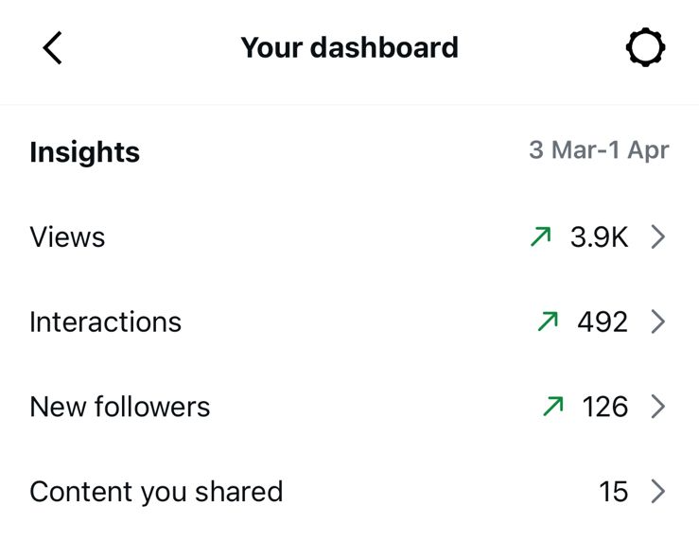
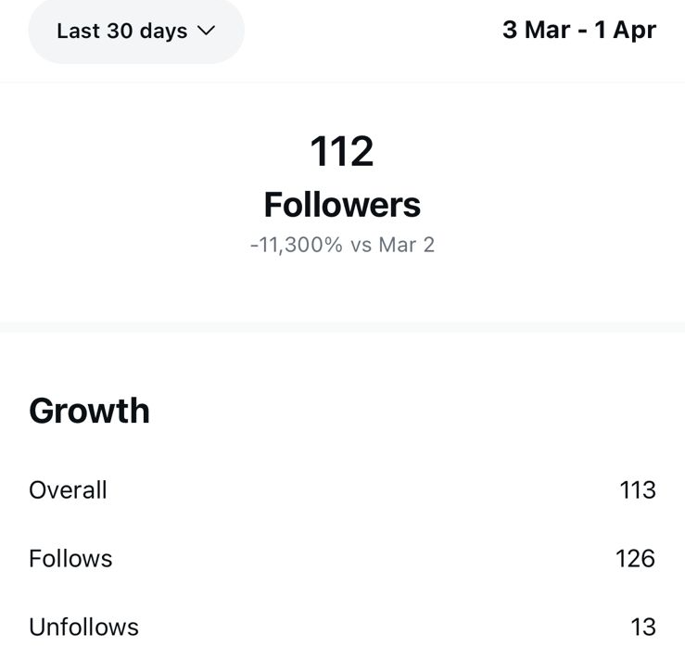
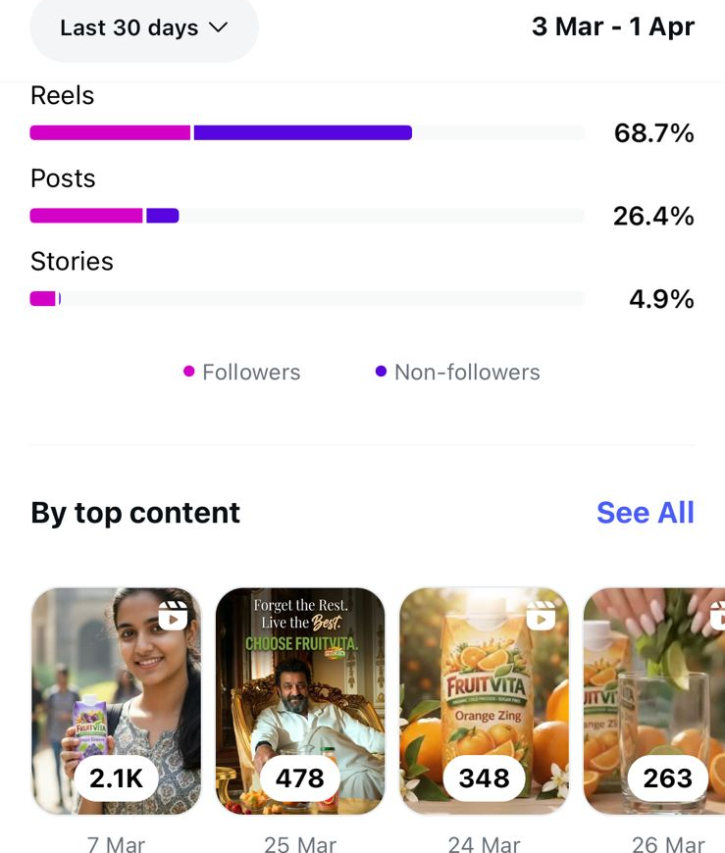
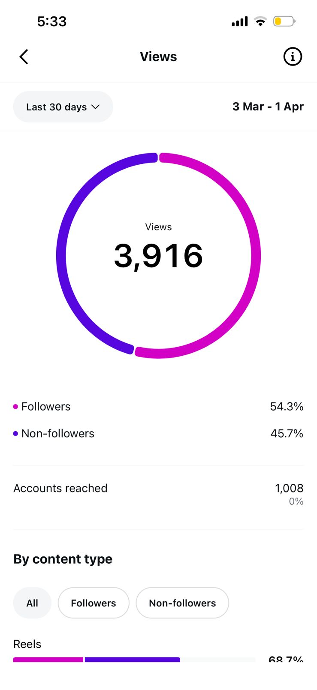
SOCIAL MEDIA – IG PROFESSIONAL DASHBOARD
IG Professional Dashboard Snapshots
Instagram Insights
@fruitivita_official
Professional dashboard snapshots taken on Wednesday night
Profile Links Added
Instagram:@fruitivita_official

Slide 23
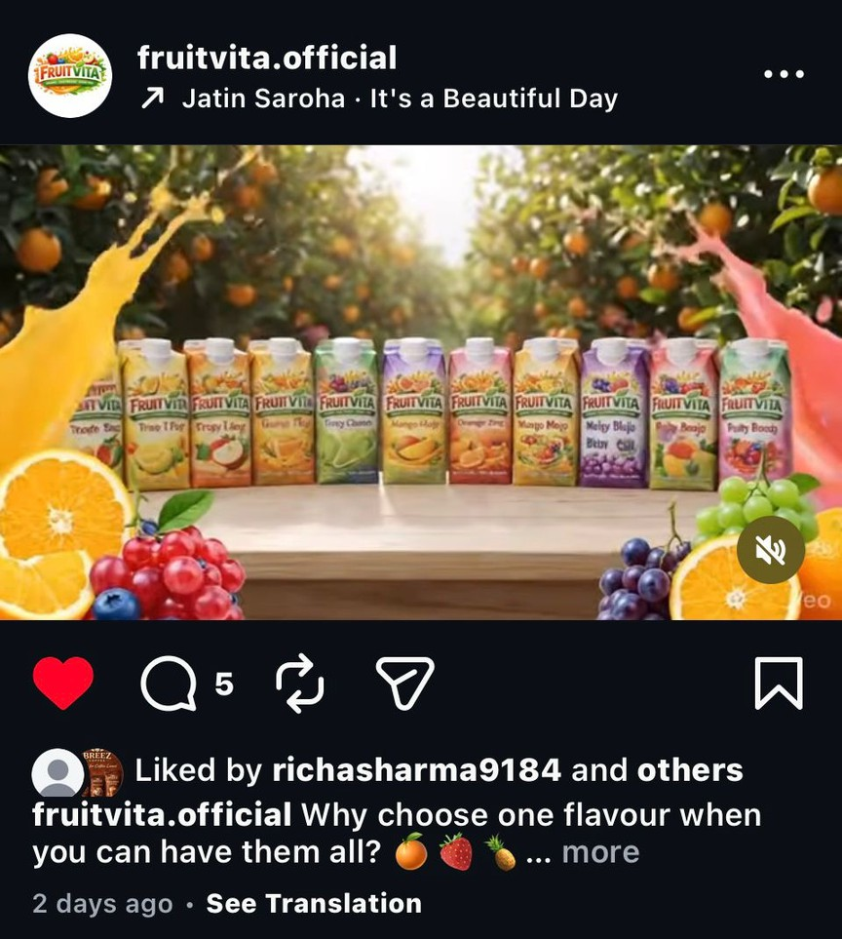
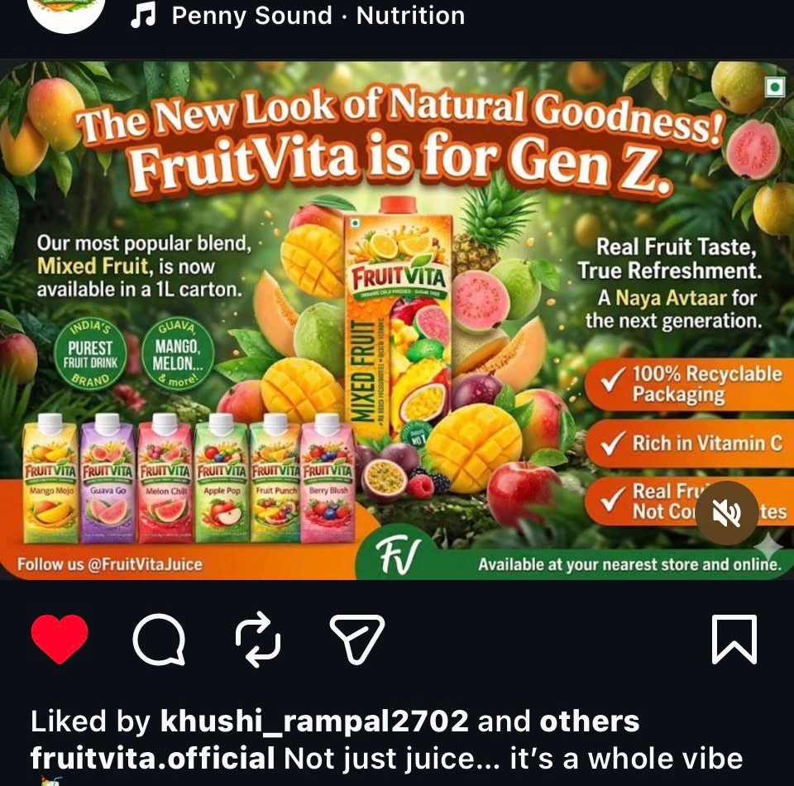
META ADS — CREATIVE VISUALS
INSTAGRAM POST — @fruitvita.official
META AD CREATIVE
@fruitvita.official · Product range reveal · 'Why choose one flavour?'
Meta ad creative · Designed for IG Feed & FB Stories

Slide 24
EMAIL MARKETING – LEAD MAGNETS & NURTURING
WELCOME SERIES & NURTURING FLOW
Day 0
Welcome to FruitVita
Day 2
Here's Why Zero Sugar Actually Tastes Better
Email Marketing
Welcome
Brand story + values. Deliver lead magnet PDF. Set expectations.
Educate
Educational content + blog link. Builds trust with science.
3 capture methods
+
Welcome series
+
Cart abandonment
Day 4
What Our Customers Are Saying
Day 6
Meet Our Best Sellers
Social Proof
UGC testimonials + 5-star reviews. Social proof email.
Product
Top 3 SKUs spotlighted — Mango Mojo, Melon Chill, Apple Pop.
Push Notification
Lead Method 1
Email Pop-up
Lead Method 2
Day 8
Your Exclusive 15% off — Today Only
Trigger
You left something behind!
Lead Magnet
Lead Method 3
Convert
Time-limited discount code. Clear CTA to shop on website.
Retarget
Cart abandonment — recover lost sales with urgency message.

Slide 25
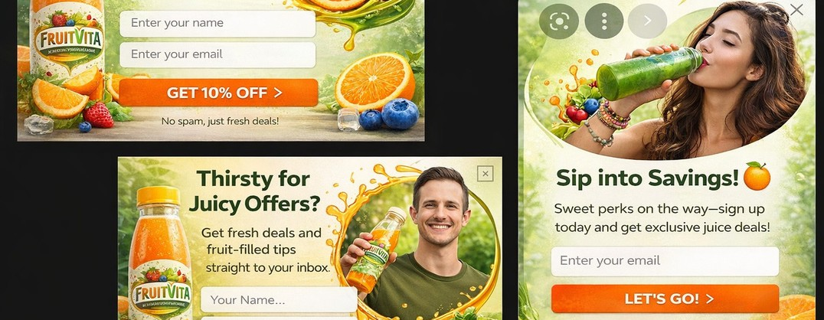
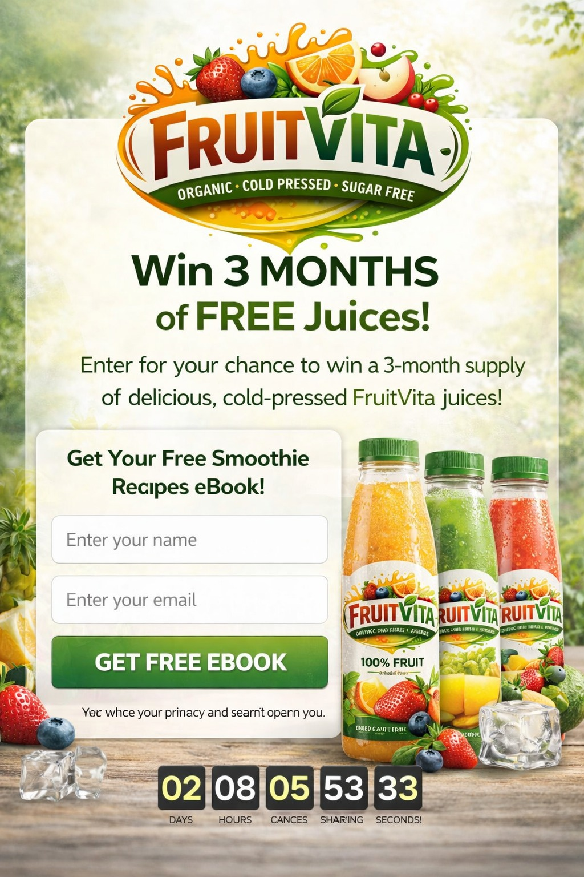
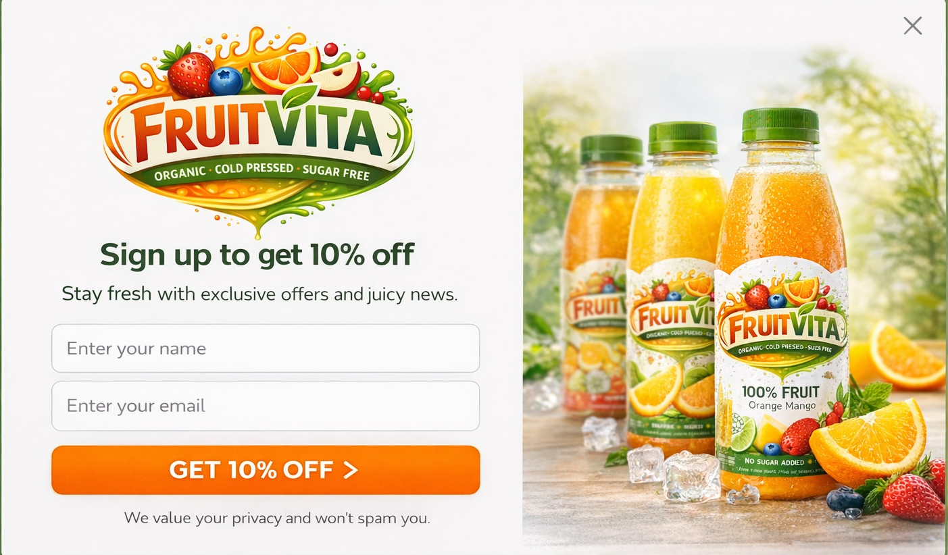
EMAIL MARKETING — LEAD CAPTURE METHODS
EMAIL SIGNUP PDESIGNSOP-UP VARIANTS (3)
LEAD MAGNET — FREE EBOOK + GIVEAWAY
3 pop-up variants: Get 10% Off · Thirsty for Juicy Offers · Sip into Savings — No spam, just fresh deals!
LEAD MAGNET — 10% OFF SIGNUP
Win 3 Months of FREE Juices! ·
Get Free Smoothie Recipes eBook · Countdown timer CTA
Sign up & get 10% off · FruitVita product range · Stay fresh with exclusive offers

Slide 26
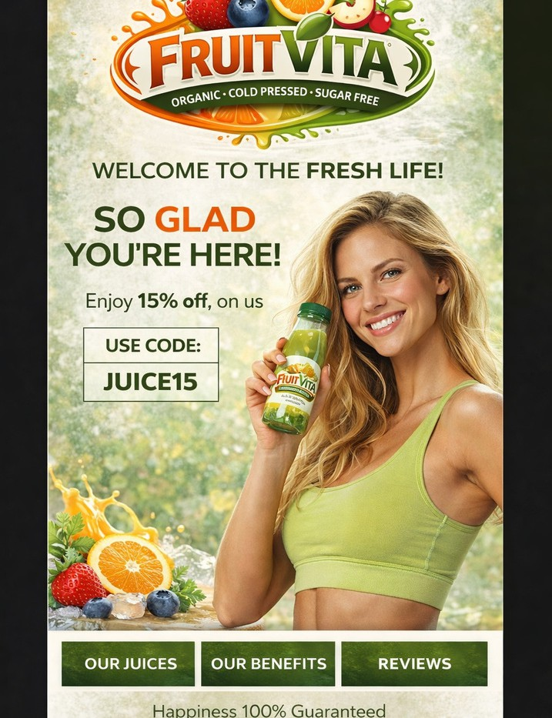
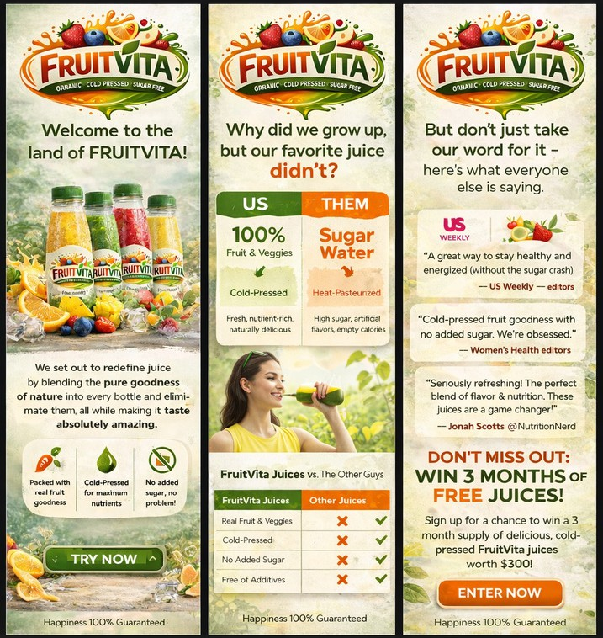
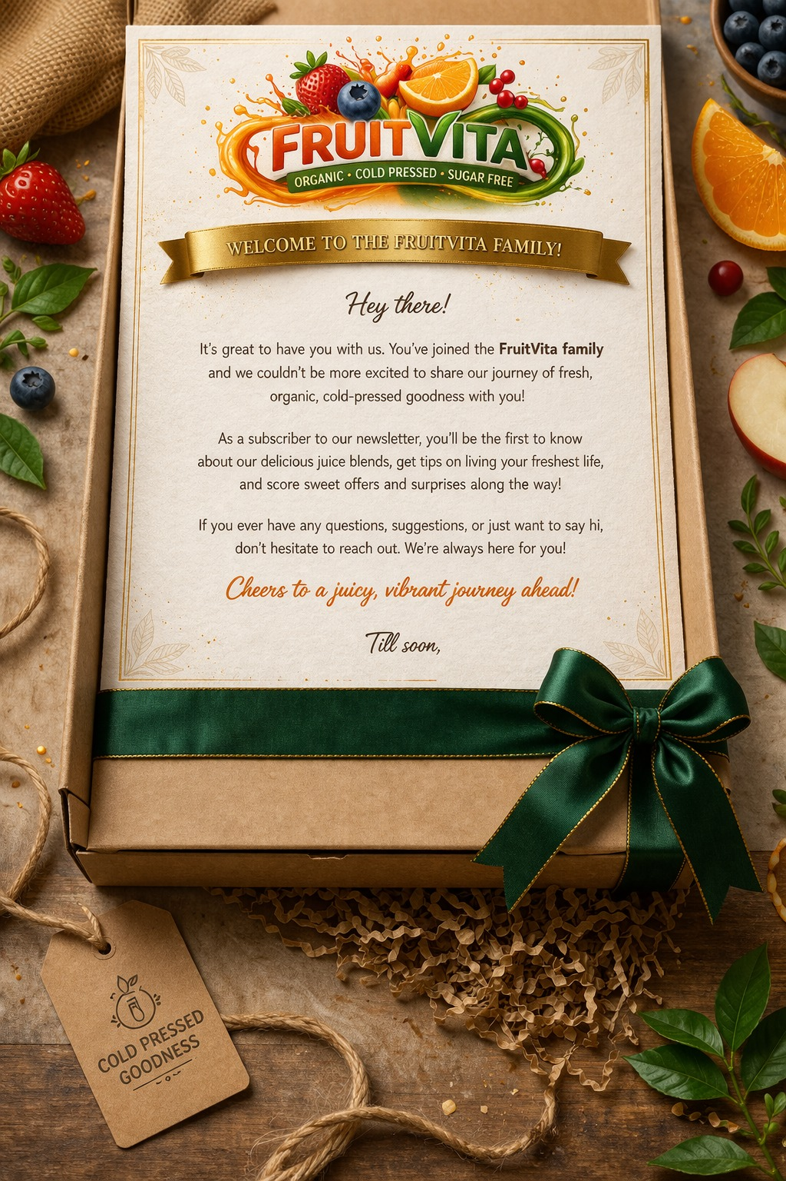
Day 0 onboarding · Brand story · 15% welcome offer
EMAIL MARKETING — WELCOME SERIES
WELCOME EMAIL — 15% OFF (CODE: JUICE15) 3-EMAIL WELCOME
BRAND STORY WELCOME LETTER
Welcome to the Fresh Life! · Enjoy 15% off on us · USE CODE: JUICE15
Email 1: Brand intro · Email 2: FruitVita vs Others · Email 3: Social proof + CTA
Welcome to the FruitVita Family · Organic · Cold Pressed · Sugar Free journey

Slide 27
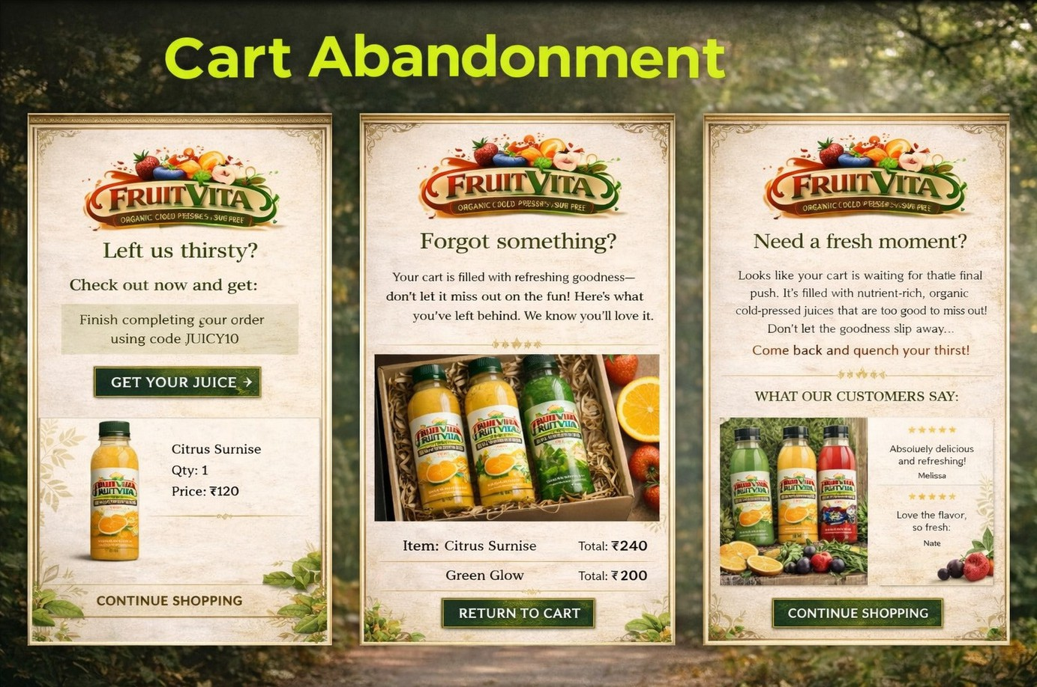
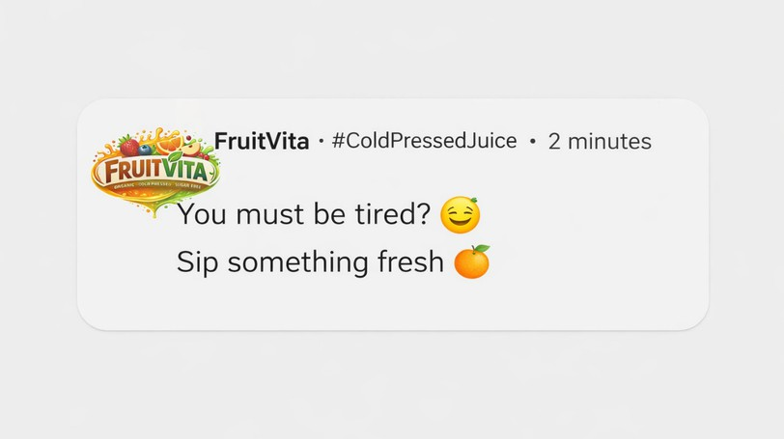
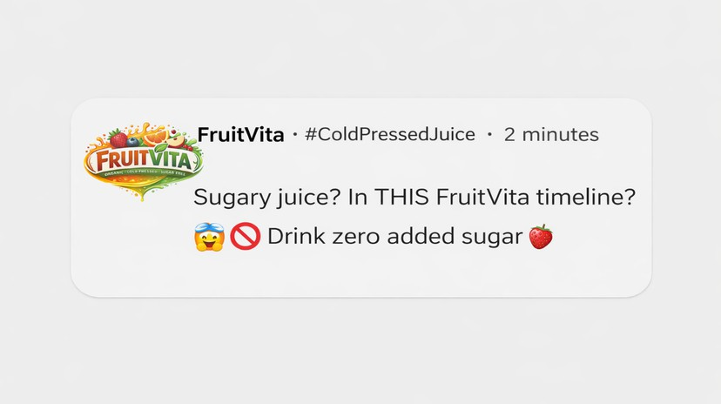
EMAIL MARKETING — CART ABANDONMENT & PUSH NOTIFICATIONS
CART ABANDONMENT EMAIL SERIES (3 TOUCHPOINTS) PUSH NOTIFICATION 1
You must be tired? Sip something fresh · #ColdPressedJuice
PUSH NOTIFICATION 2
Email 1: Left us thirsty? · Email 2: Forgot something? · Email 3: Need a fresh moment? · Discount code JUICY10
Sugary juice? In THIS FruitVita timeline?
Drink zero added sugar

Slide 28
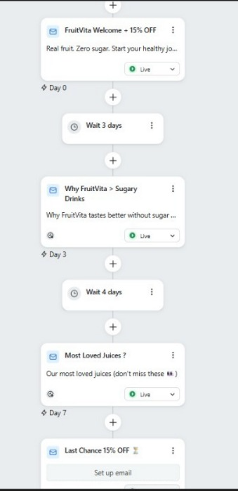
DAY 0 – WELCOME OFFER
• Instant email + 15% OFF
• Objective: First purchase
DAY 3 – EDUCATION MAIL
• Benefits of cold-pressed, zero sugar
• Objective: Build trust
DAY 7 – BEST SELLERS
• Top flavours recommendation
• Objective: Easy decision making
FINAL – URGENCY REMINDER
• Limited time discount reminder
• Objective: Increase conversion
STRATEGY
Awareness → Trust → Conversion using automated email journey

Slide 29
CONCLUSION & KEY TAKEAWAYS
Building FruitVita digitally showed that Digital Marketing is not one activity but a combination of strategy, data and creativity
Identifying health-conscious audience helped select the right platforms (Google + Meta + Instagram)
Keyword research revealed strong demand for sugar-free, organic and cold-pressed drinks
Google Ads helped capture users already searching for healthy drink alternatives
Meta Ads and social content helped create awareness and brand recall for FruitVita
Funnel strategy ensured users moved from awareness → trust → purchase
Consistent communication of FruitVita USP (Zero Sugar, Organic, Cold Pressed) across all channels strengthened positioning
Integration of Ads + Content + Email marketing created a structured customer journey

Slide 30
“FruitVita – From Idea to Execution (Working Outcome)”
https://drive.google.com/drive/folders/15BhGVwL96ztEbXEm0XkM4
_FFN8oFMWcI?usp=sharing

